Slide 1
NMC/QAA introduction event
Anne Trotter and Sophia Hunt – NMC
Rob Stroud – QAA
30 and 31 October 2024

Slide 2
Housekeeping
We’re running this session twice: Weds 30 Oct and Thurs 31 Oct.
We will be recording each session and uploading to our website.
Please feel free to use Q&A function to ask questions. We will try to answer as many as we can.
The ‘raise your hand’ feature is also enabled if you’d like to come off mute to ask your question. Please reserve your questions until the Q&A.
Attendees can switch on live captioning for accessibility.
Further questions and comments can be emailed to QAteam@nmc-uk.org

Slide 3
Agenda
The NMC: welcome, introductions and the future direction
The Quality Assurance Agency: what’s new
Q&A

Slide 4
A lot has happened this year
Mandatory exceptional report 2024
The Quality Assurance Agency began services on
1 Sept 2024
Pre-reg programme standards transition - deadline extended to 31 July 2025
Simulated practice learning evaluation
Practice learning review
Advanced practice review
Pre-2022 post registration standards withdrawn on 31 Aug 2024
Independent culture review

Slide 5
Meet the NMC Education QA team
Anne Trotter, Assistant Director, Education and Standards
Adriana Zajdel, Contract Manager
Sophia Hunt, Head of Education Quality Assurance
Caroline Dobson, Senior Lead Nurse and Education Quality Assurance Manager
Melaine Coward, Specialist Advisor for Education Quality Assurance
Suzanne Crozier, Lead Nurse and Midwife for Education Quality Assurance
Tamara Wasylec, Senior Education Quality Assurance Officer
Krutika Patel, Education Quality Assurance Officer
Vicky Forrest, Education Quality Assurance Officer
Shadae Riley, Education Quality Assurance Officer
Bejal Pattni, Education Data Analyst
Yvonne Kipkurui, EdQA Administrative Assistant
Carole Carter, EdQA Administrative Assistant

Slide 6
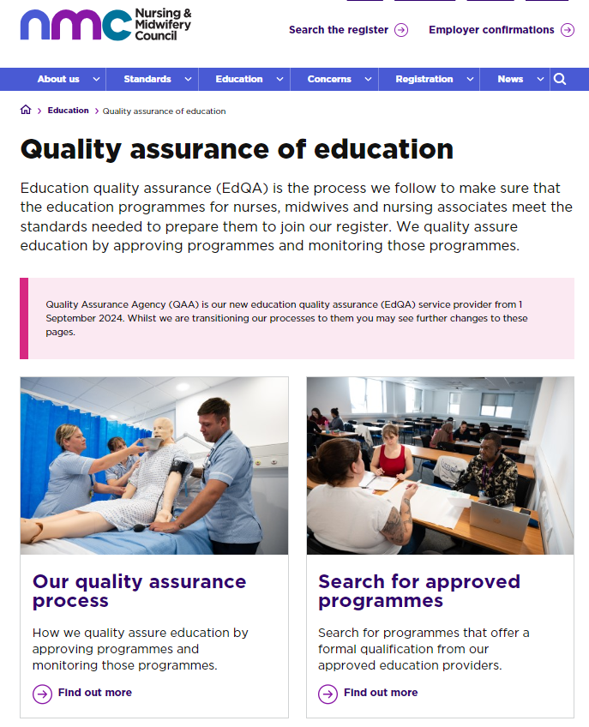
New partnership with the Quality Assurance Agency
Refreshed QA framework
Updated EdQA webpages to improve accessibility and navigation – based on feedback
Focus has been on priority events; new programme approval and modification to approved programmes - high volume set to continue

Slide 7
Improving education quality assurance
Clearer processes informed by your feedback
Learning together: making the most of and sharing best practice
Supportive approach that reflects our outcome focused standards and promotes innovation and creativity for nursing and midwifery education
Ongoing understanding the complex landscape for nursing and midwifery education
More opportunities for us to listen to your feedback and for you to shape our approach

Slide 8
QAA – delivering quality assurance for the NMC and the UK HE sector
Presentation by Rob Stroud – Director of Quality Assurance Services

Slide 9
What’s been going on?
QAA’s contract commenced on 1 September 2024.
We spent the summer working with NMC to explore the detail of the previous processes, make some changes, and be ready to pick up the activities that were queued ASAP.
We commenced early engagement with individual providers in August 2024, as well as wider AEI engagement in September (focussing on the process).
We’ve had an implementation team in place, while we worked out transition arrangements and made final appointments to posts.
We have recruited and trained visitors.
We have been scheduling and deploying teams according to priority timelines for providers based on programme start dates (primarily) and other factors. As of today, there are 29 “live” reviews, with 50 more at various stages of the planning process – altogether covering over 300 different programmes.

Slide 10
Meet the team
Rob Stroud – Director of Quality Assurance Services
Jennifer Taylor – Director of Contract Services
Adam Surtees - Head of NMC Operations and Delivery
Jo Miller – NMC Quality Officer
Jo Green - NMC Quality Officer
Vacancy – NMC Quality Officer
Leanne Ennis – NMC Coordinator
Registrant Nurse – NMC Stakeholders and Analytics Manager
Registrant Midwife – NMC Stakeholder and Analytics Manager
Vacancy – NMC Research and Analytics Officer
Registrant input
Overall team management and oversight of operations, scheduling etc.
Oversight of individual reviews
If you are currently undergoing a review activity you may also be working with one of our other quality officers as we have brought in additional resource to manage the built up demand, and the setup of activities.
Also have dedicated resource elsewhere – specific post to manage the NMC visitor pool for example.
Front line customer service

Slide 11
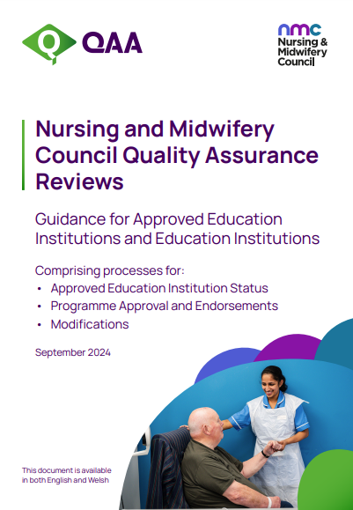
What’s new?
We have already implemented a number of changes:
- New website – www.qaa.ac.uk/nmc
New handbook for reviews (approvals and mods)
QAA officers for coordination and guidance for every review
New visitor pool
New timelines
Changes to process

Slide 12
Changes to process
If you have been through an NMC approval or modification process before there are some changes we have implemented. We hope this can improve your experience.
Evidence submission – submit all gateways at once – allows us to work at a faster pace when we can see everything at once.
Changes to the number of visitors – we have made some changes to visitor allocations in order to ensure there are multiple viewpoints.
Changes to visit agendas – allowing more time for engagement with the programme team.
IDPAR – no longer issued and replaced with “Lines of enquiry” – clearer for AEIs to understand what is likely to be focussed on during the visits.
Separation of factual accuracy checking and the observations period.
Changes to feedback arrangements.
Please note in some cases we have made other minor changes for the reviews from September onwards for providers with early 2025 start dates.

Slide 13
What’s coming?
There are a number of further enhancements we have begun working with NMC colleagues to consider implementing for the future:
Student visitors – coming this winter with pilot approaches for other models in 2025
Greater clarity and proportionality in the major modifications approach
Thematic reporting – creating value from the individual quality assurance activities being considered collectively – for the NMC and for AEIs
A range of other measures based on feedback the NMC and QAA have heard!
Additionally, QAA will be picking up a range of other QA activities as commissioned by the NMC.
For the avoidance of doubt, changes will be communicated and handbooks and other materials updated accordingly in due course as changes are implemented.

Slide 14
Engaging with QAA
We encourage early engagement if you want to talk to us about plans you have for approval and modification requests. AEIs do not have to wait until they are ready to submit everything before talking to us!
We particularly encourage providers considering significant changes, or changes they would like implemented quickly, to contact us as early as possible, so we can factor you into our planning and work with you on a realistic schedule of activities. Again, this can be before you are ready to enter your request into QA Link!
We also welcome feedback. We will send you a feedback survey after every review, but you are also welcome to contact us at any time to share your views or ask questions. We will transparently share feedback with the NMC.
nmc@qaa.ac.uk
01452 557075

Slide 15
Time for questions

Slide 16
Next steps and future focused education QA activity
Continuous improvement programme planned for education QA
Set up a UK wide Education QA Reference Group
Plus:
New initiatives in the pipeline – i.e. pilot activity for the introduction of student visitors to the visitor team
Ongoing consideration of approach to programme monitoring

Slide 17
Useful information
Education Quality Assurance
qateam@nmc-uk.org
The Code and Standards related queries
educationandstandards@nmc-uk.org
Come along to our education and standards drop ins
First Wednesday of every month, 12.30-13.30.
Please fill in this short form to receive the joining details.
We plan to continue sharing monthly email updates (sent to official correspondents and lead midwives for cascading) – please let us know if these are useful for you.

Slide 18
Thank you

